Slide 1
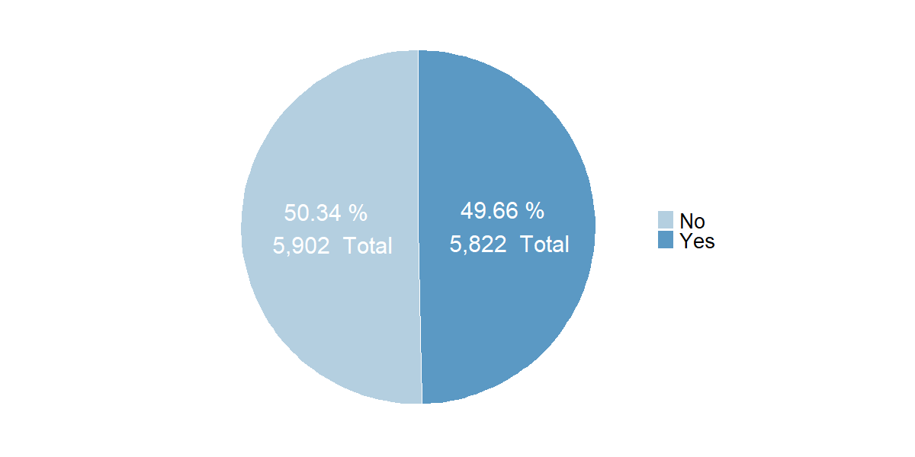
Unique Buildings by Disadvantaged Community (DAC) Indicator
Note: No (Non-Disadvantaged Community), Yes (Disadvantaged Community)

Slide 2
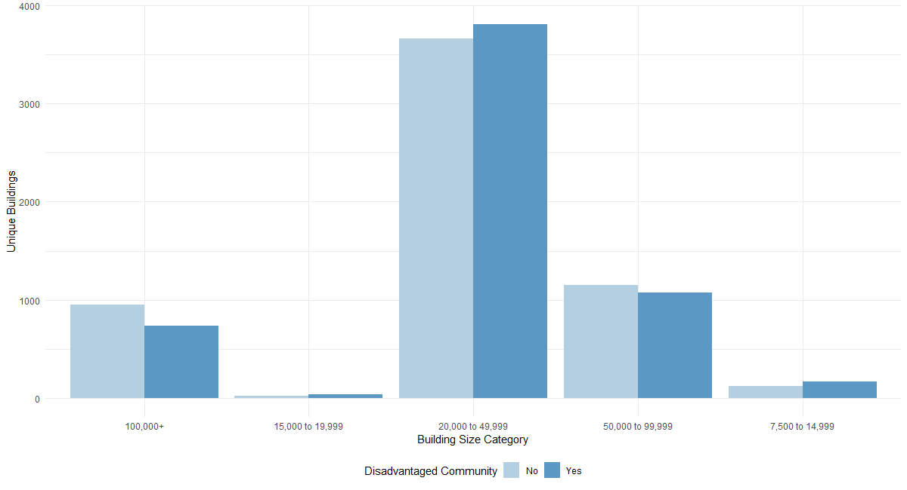
Unique Buildings by DAC Indicator and Building Size Category

Slide 3
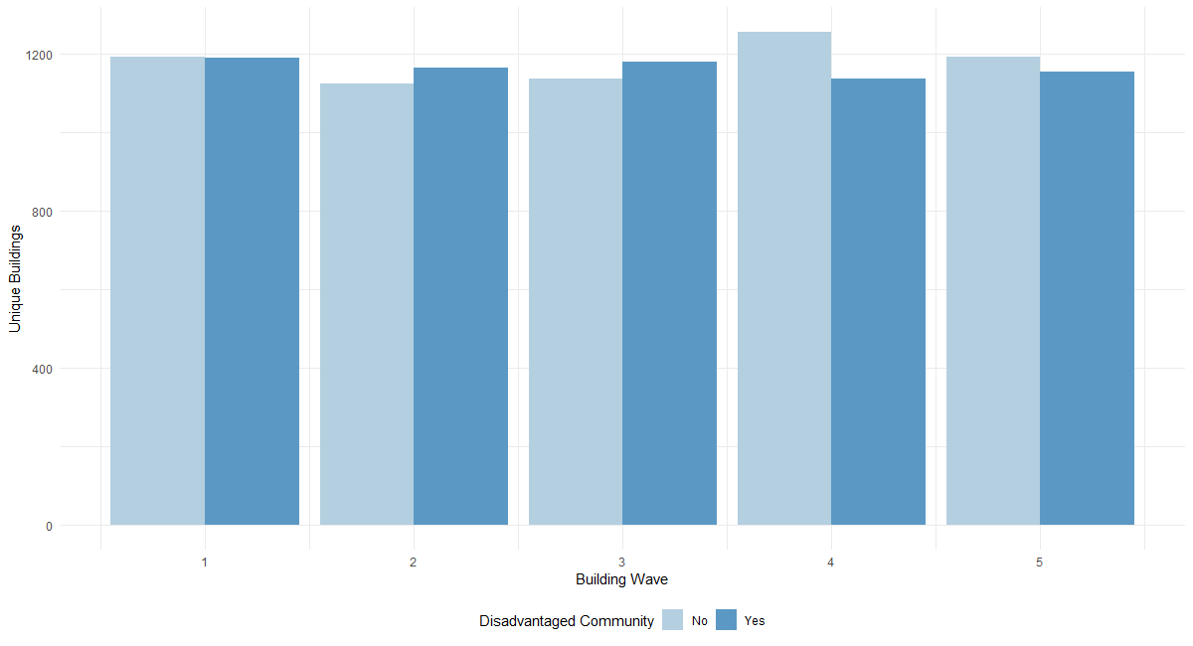
Unique Buildings by DAC Indicator and Building Wave

Slide 4
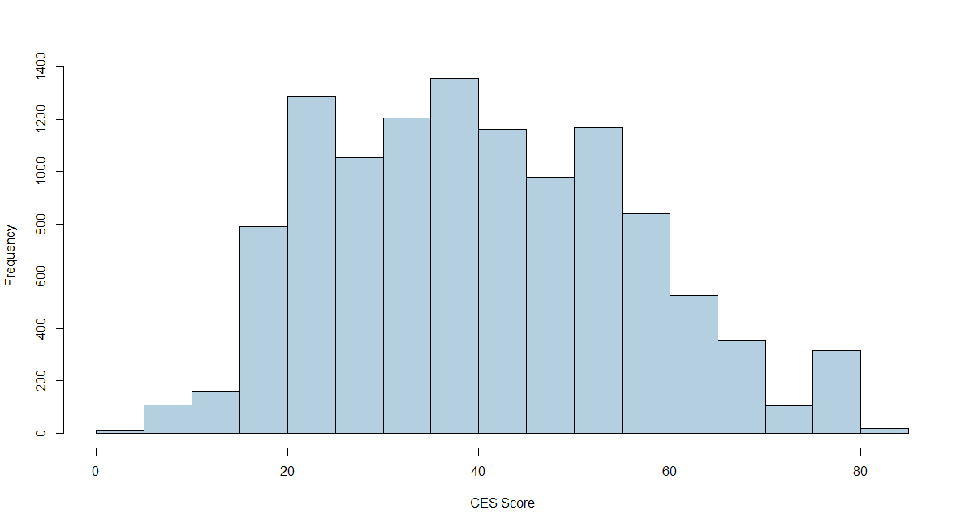
Histogram of CalEnviroScreen Scores

Slide 5
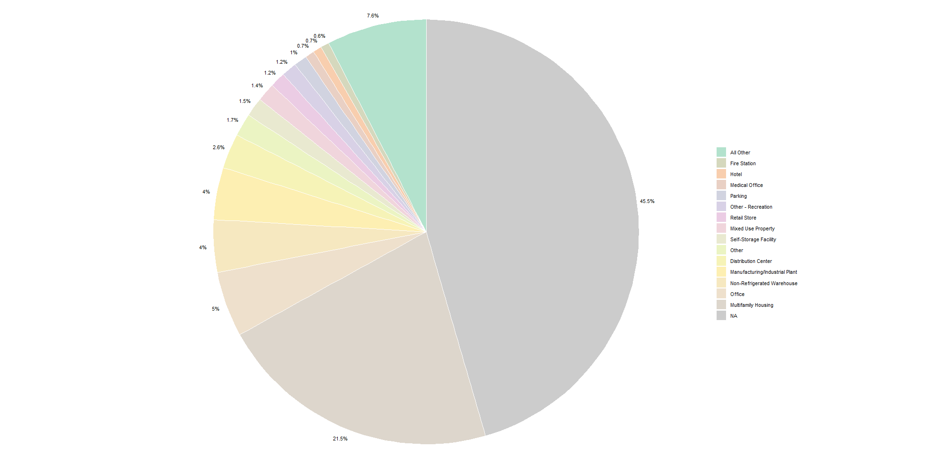
Top Property Types in Disadvantaged Communities (Top 15 included)

Slide 6
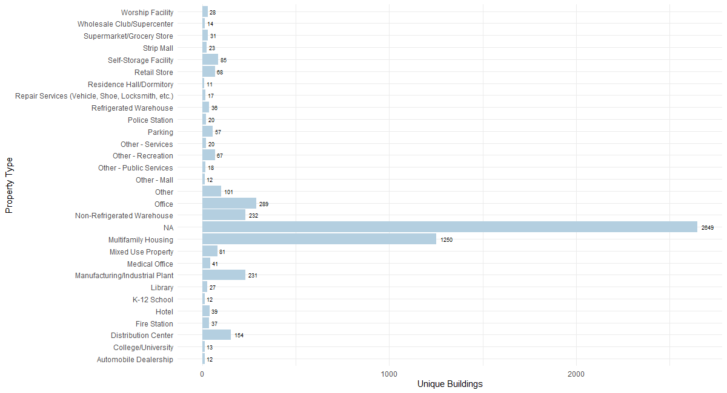
Top Property Types in Disadvantaged Communities (Top 30 included)

Slide 7
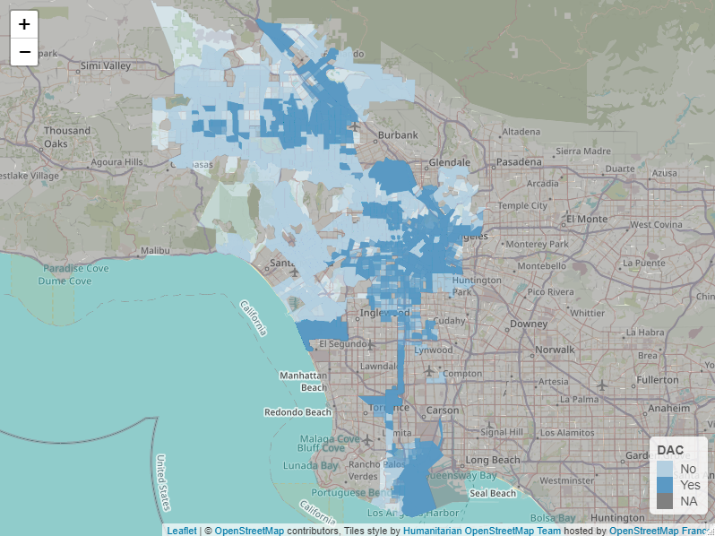
Census Tract Map

Slide 8
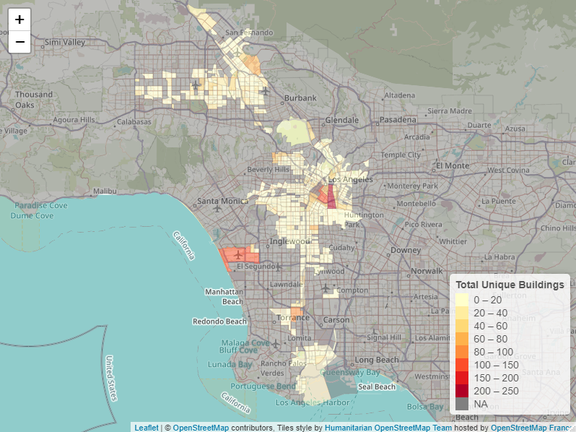
Census Tract Map (Disadvantaged Communities)
Five Census Tracts visibly indicated contain the largest concentrations of unique buildings for the subset of all unique buildings within a DAC.
These Census Tracts are as follows:
6037206031 with 233 unique buildings
6037226002 with 145 unique buildings
6037980028 with 140 unique buildings
6037207301 with 112 unique buildings
6037292000 with 86 unique buildings
The remainder of the census tracts in Disadvantaged Communities contain between 1 to 73 unique building observations each.

Slide 9
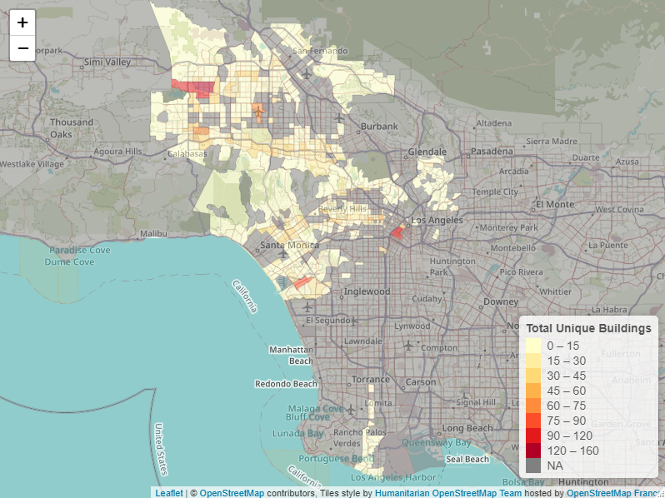
Census Tract Map (Non-Disadvantaged Communities)
Five Census Tracts visibly indicated contain the largest concentrations of unique buildings for the subset of all unique buildings not within a DAC.
These Census Tracts are as follows:
6037113303 with 147 unique buildings
6037207710 with 116 unique buildings
6037113421 with 102 unique buildings
6037113237 with 98 unique buildings
6037207900 with 92 unique buildings
The remainder of the census tracts in Non-Disadvantaged Communities contain between 1 to 78 unique building observations each.

